Slide 1

Unity Scripting
Immersive Media & Game Development
School of IIT
Temasek Polytechnic

Slide 2

What the designer sees

Slide 3

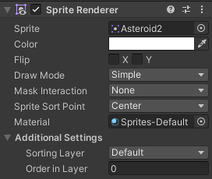
Recap: GameObjects and Components
The SpriteRenderer component renders a sprite associated with the GameObject
A GameObject is an object in the game scene.
Empty GameObject
Every GameObject has a Transform component to specify its position in 2D or 3D space.
A GameObject can be empty.
Attach component
An empty GameObject only has a Transform component.
Object behaviour is defined in components.
Components are scripts attached to GameObjects with code to implement functionality.

Slide 4
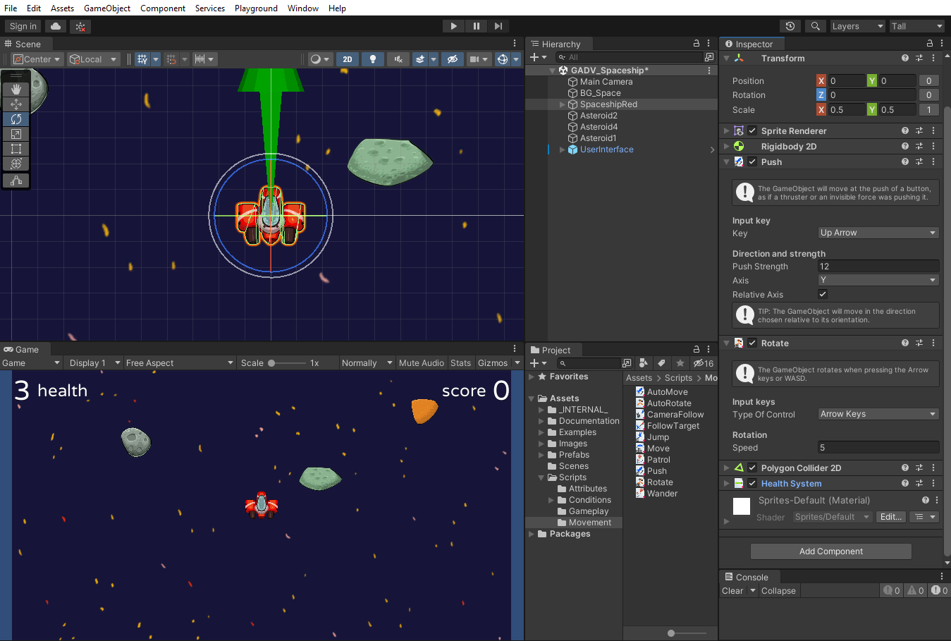


Adding script components
Usually, we need to add our own game specific code to our GameObjects.
Asteroid1
Where does this code come from?
Scripts
1
Scripts are added to an object by:
AutoRotate
1.
Dragging a script onto an object in the Scene view or Hierarchy
2.
Dragging a script onto an object’s Inspector panel
2
3
3.
Clicking Add Component to find and add a script
Scripts in the Project window

Slide 5
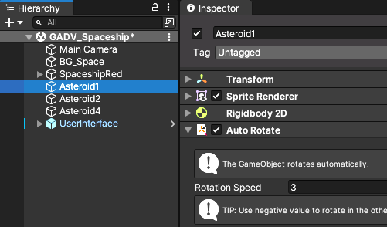
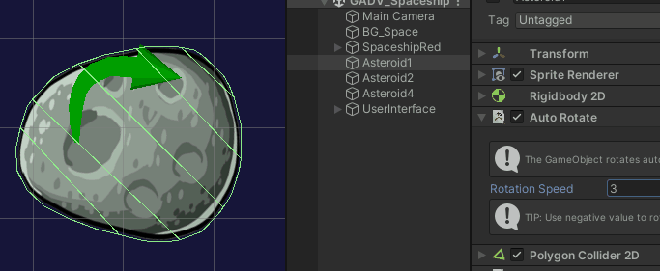
Each script attached to a game object is shown in the Inspector.
Scripts may have fields where you set property values.
Here, Asteroid1’s rotation speed is set to 3.
A script can be set to active or inactive by clicking its checkbox.
And that’s pretty much it!
What about the game programmer?
AutoRotate script

Slide 6
What the programmer sees

Slide 7
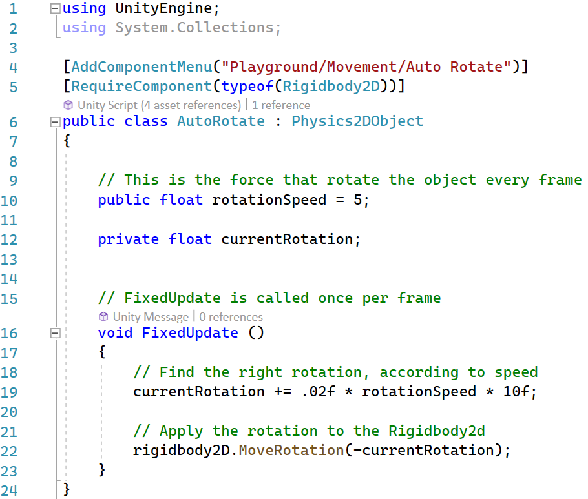
AutoRotate script: closeup!
namespace
class name
superclass name
public variable declaration
private variable declaration
private function
Update currentRotation
Apply the rotation

Slide 8

Explain how this code works:
Copy and paste this query into Chat GPT, and then the code below.
using UnityEngine;
using System.Collections;
[AddComponentMenu("Playground/Movement/Auto Rotate")]
[RequireComponent(typeof(Rigidbody2D))]
public class AutoRotate : Physics2DObject
{
// This is the force that rotate the object every frame
public float rotationSpeed = 5;
private float currentRotation;
// FixedUpdate is called once per frame
void FixedUpdate ()
{
// Find the right rotation, according to speed
currentRotation += .02f * rotationSpeed * 10f;
// Apply the rotation to the Rigidbody2d
rigidbody2D.MoveRotation(-currentRotation);
}
}
Then try these …
Write a C# script to make an object with a Rigidbody rotate continuously in Unity.
Explain how the code above works.

Slide 9
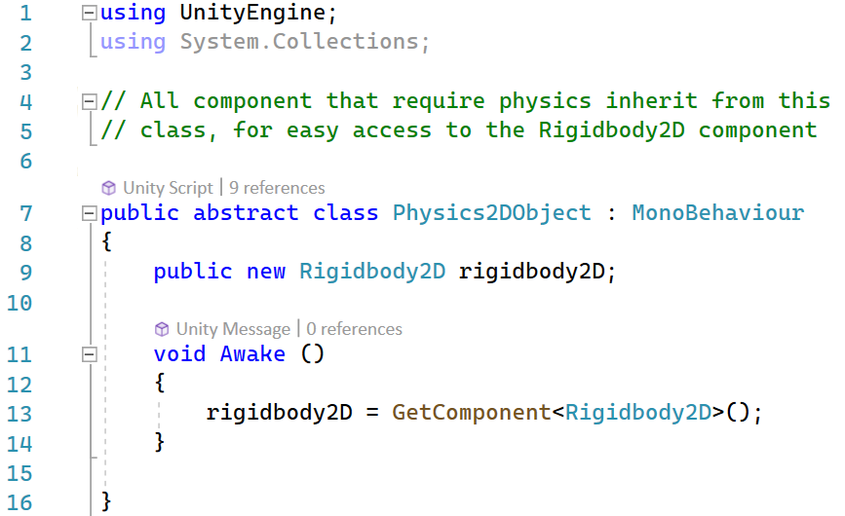
Physics2DObject script
This is the parent class of AutoRotate.
AutoRotate inherits all the public properties and functions from its parent class.
What do you think the GetComponent function does?
???
An abstract class cannot be instantiated.
Abstract classes define common properties and functionality for their subclasses.

Slide 10

Scripts as components
https://learn.unity.com/tutorial/scripts-as-behaviour-components
Notes:
Go to: https://learn.unity.com/tutorial/scripts-as-behaviour-components
This is the Unity Learn page for this video.

Slide 11
Scripts as components
Every component is actually a class (or a struct), either as a part of the Unity API or as a class written in a script.
using UnityEngine;
using System.Collections;
public class ExampleBehaviourScript : MonoBehaviour
{
void Update()
{
if (Input.GetKeyDown(KeyCode.R))
{
GetComponent<Renderer> ().material.color = Color.red;
}
if (Input.GetKeyDown(KeyCode.G))
{
GetComponent<Renderer>().material.color = Color.green;
}
if (Input.GetKeyDown(KeyCode.B))
{
GetComponent<Renderer>().material.color = Color.blue;
}
}
}
What is MonoBehaviour?
Next slide …
Copy and paste the code into ChatGPT with this query:
Explain how this code works.

Slide 12
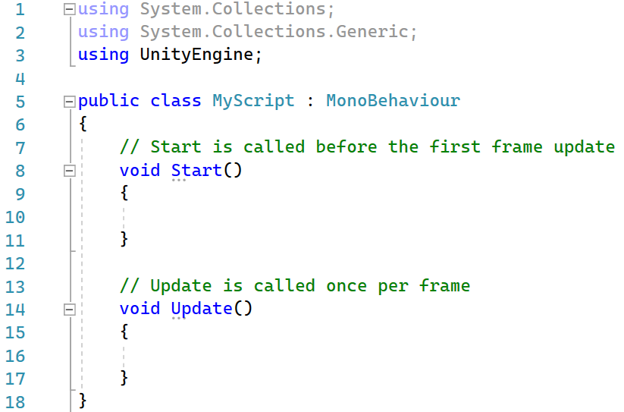
MonoBehaviour
The MonoBehaviour class is the base class from which every Unity script derives, by default.
When you create a C# script from Unity’s project window, it automatically inherits from MonoBehaviour, and provides you with a template script.
The MonoBehaviour class provides the framework which allows you to attach your script to a GameObject in the editor.
Template script
This URL has a good overview:
http://clarkkromenaker.com/post/unity-monobehaviour-usage

Slide 13
MonoBehaviour methods
MonoBehaviour hooks you into the game loop.
Update()
FixedUpdate()
LateUpdate()
…
These methods are inherited from MonoBehaviour.

Slide 14
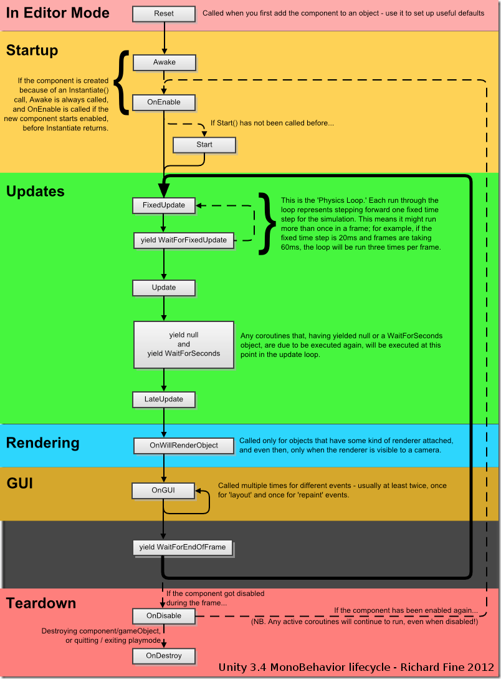
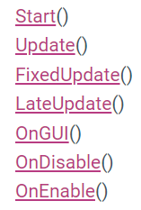
MonoBehaviour
lifecycle
You subclass MonoBehaviour to inherit its public properties and method.
Some important methods are:
MonoBehaviour methods are called in a particular sequence.
You don’t have to remember this in detail, but it’s good to know the key lifecyle stages.
https://hackingwithunity.com/pou-xi-monobehaviour/
https://docs.unity3d.com/ScriptReference/MonoBehaviour.html

Slide 15
MonoBehaviour lifecycle
In Unity what is the MonoBehaviour lifecycle?

Slide 16
MonoBehaviour lifecycle
Update is called every frame, if the MonoBehaviour is enabled.
Update is the most commonly used function to implement any kind of game script.
LateUpdate is called after all Update functions have been called. This is useful to order script execution.
For example a follow camera should be implemented in LateUpdate because it tracks objects that might have moved inside Update.
We’ll look at coroutines later (if time permits)

Slide 17
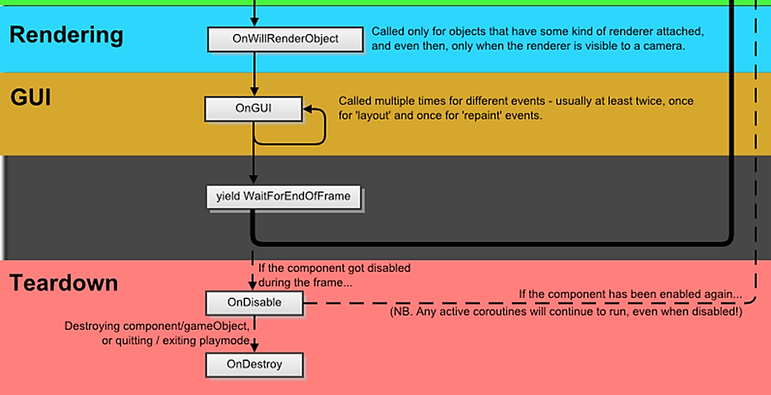
MonoBehaviour lifecycle

Slide 18

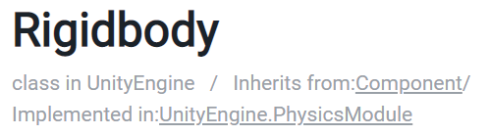
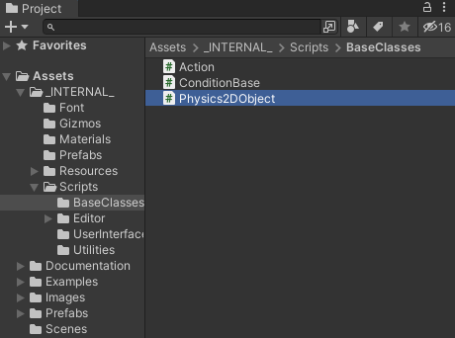
User classes vs. API classes
Unity comes with many built-in classes that you can access as part of its API.
An example is Rigidbody, which hooks an object into the physics engine.
For any complex game, you will also write your own classes, as C# scripts.
If your class is designed to be a component on a GameObject, then it should subclass MonoBehaviour.
You can also write stand-alone classes that do not subclass MonoBehaviour.
A good example would be a class that performs game-specific math operations.

Slide 19

Advantages of component-based software design
Modularity
Components are self-contained units of functionality that can be easily added, removed, or replaced in a game object.
Reusability
Components can be reused across different game objects, reducing the need for duplicated code
Separation of concerns
It is easier to manage dependencies between different parts of the system
Ease of debugging
It is easier to isolate and fix any errors because each component is self-contained and has a well-defined scope of responsibility.
Code organization
ScriptA.cs
ScriptB.cs
Components provide a logical and organized way to structure code.
ScriptC.cs

Slide 20



Time for another …
GADV 03 – Scripting

Slide 21


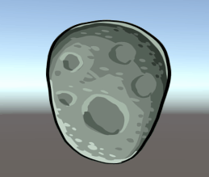
Now do the worksheet!
30 mins

Slide 22


Q&A
https://www.deviantart.com/sharfav3in/art/Super-Mario-Bros-A-Confused-Mario-842672028

Slide 23

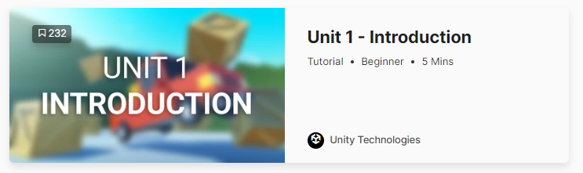
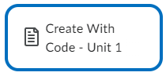
Practical
We won’t go through the whole course!
Just enough to get you started.
But feel free to complete it all in your own time ☺
You can either
Or both!
Follow the instructions in the online videos
Work through the PDF version from LMS
Note that your GADV tutor has added many notes and comments to explain the tutorial in more detail, so it’s recommended that you use the PDF.
https://learn.unity.com/project/unit-1-driving-simulation
https://learn.unity.com/course/create-with-code
Notes:
This will take a few hours.
You should try to finish all of Unit 1 by next week.
Be ready to discuss what you did and any problems/doubts you have in the next class.

Slide 24
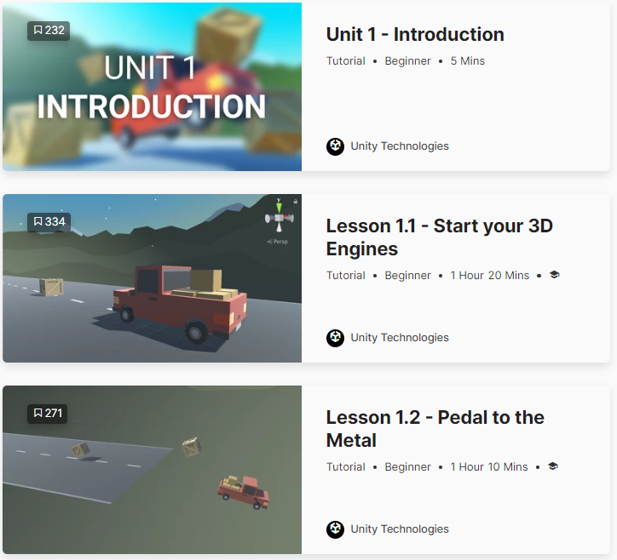
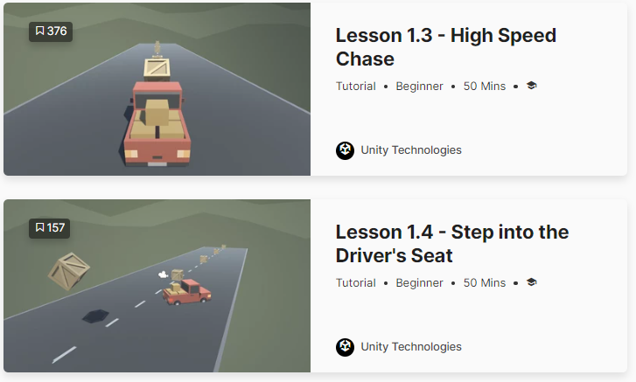
Practical
Complete up to 1.4

